Slide 1
SMART HOME APPLICATION USING TINKERCARD

Slide 2
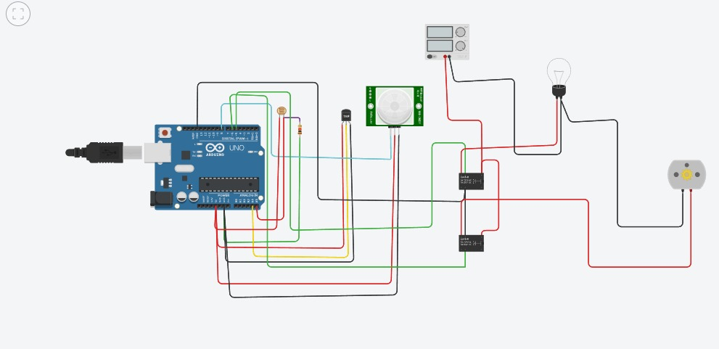
SMART HOME CIRCUIT CONNECTION:

Slide 3
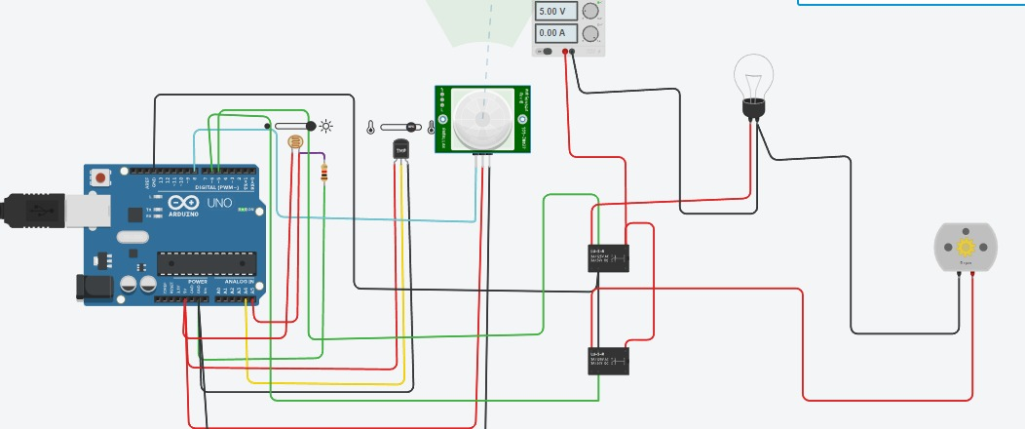
DURING DAY TIME :
When Temperature of Sensor is more then 30degree Celsius then Automatically fan will Turn ON.
Bulb Is Automatically Turn OFF At Day Time.

Slide 4
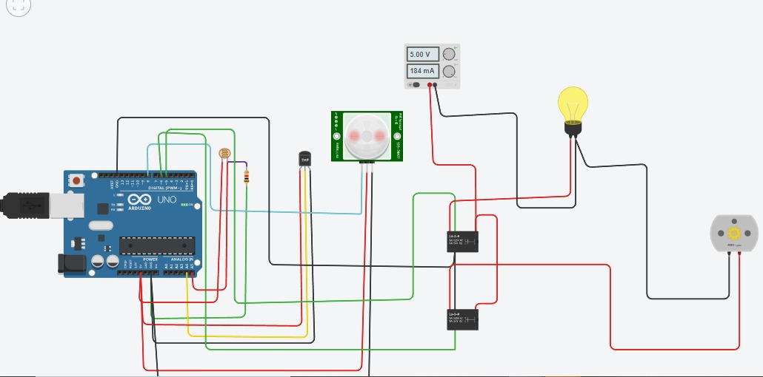
DURING DARK TIME:
When LDR Detected Dark it Turn ON Light Bulb.

Slide 5
SIMULATION OUTPUT:
float x,y,z,temp;
void setup(){
pinMode(8, INPUT);
pinMode(5, OUTPUT);
pinMode(6, OUTPUT);
pinMode(A5, INPUT);
pinMode(A4, INPUT);
Serial.begin(9600);}
void loop(){
x= digitalRead(8
y= analogRead(A5);
z= analogRead(A4);
Serial.println(x);
Serial.println(y);
Serial.println(z);
}

Slide 6
temp = (double)z / 1024;
temp = temp * 5;
temp = temp - 0.5;
temp = temp * 100;
if ( (x>0) ) { if ((y<550)&&(temp>30)) {
digitalWrite(5, HIGH);
digitalWrite(6, HIGH); }
else if((y<550)&&(temp<30)) {
digitalWrite(5, HIGH);
digitalWrite(6, LOW); }
else if((y>550)&&(temp>30)) {
digitalWrite(5, LOW);
digitalWrite(6, HIGH); }

Slide 7
else if((y>550)&&(temp<30)) {
digitalWrite(5, LOW);
digitalWrite(6, LOW); } }
else {
digitalWrite(5, LOW);
digitalWrite(6, LOW); }
}

